Slide 1
Chapter - 2 Fundamental concepts and Introduction to C#

Slide 2
Contents
C# & Microsoft Visual Studio
C# Console based Applications

Slide 3
C#
Object-oriented programming language and part of the .NET family from Microsoft.
Very similar to C++ and Java.
C# is the programming language, while Microsoft Visual Studio is the development environment.

Slide 4
Microsoft Visual Studio
is an integrated development environment (IDE).
Used to develop console and graphical user interface applications along with Windows Forms applications, web sites, web applications, and web services
Shares a single integrated development environment (IDE) that is composed of several elements: the Menu bar, Standard toolbar, various tool windows docked or auto-hidden on the left, bottom, and right sides, as well as the editor space

Slide 5
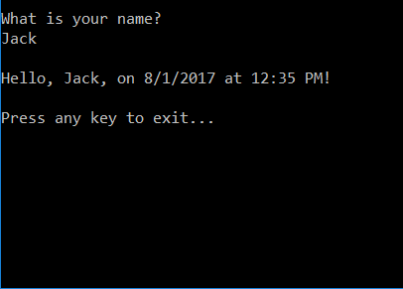
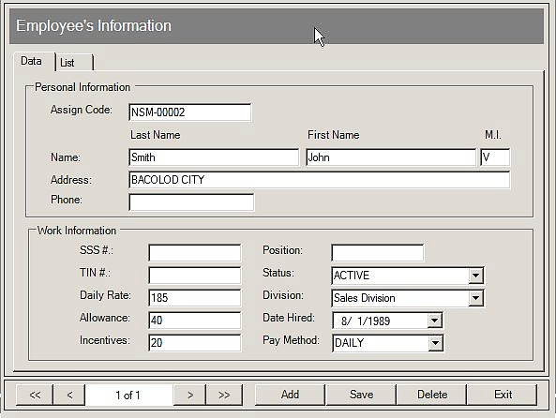
C# sample programs
C# allows us to write programs like Console Based Applications as well as Windows Based Applications.

Slide 6
Solution Explorer
Solutions and projects contain items that represent the references, data connections, folders, and files that you need to create your application.
A solution container can contain multiple projects

Slide 7
Toolbox
The Toolbox contains all the necessary controls for our user interface like Button, Textbox, Checkbox e.tc.
You need to create your user interface.
In order to use them in our user interface, we just drag and drop them to the “Form”, as shown below:

Slide 8
Cont..

Slide 9
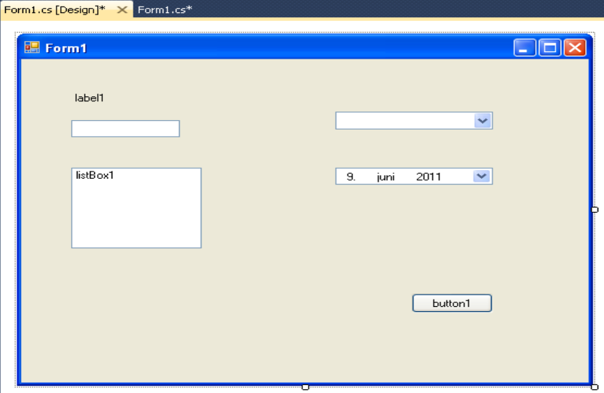
Editors and Designers
1. Graphical User Interface Designer:

Slide 10
Cont..
2. Code Editor:

Slide 11
Properties window
On our user interface each control has lots of Properties which can set.

Slide 12
Build and Debug Tools
In Visual Studio we have lots of Build and Debugging Tools.
The most used tool is “Build Solution” (Shortcut Key: F6).
The most used tool is “Start Debugging” (Shortcut Key: F5).

Slide 13
C# Console based Applications
A console application is an application that can be run in the command prompt in Windows
So that they are easy to develop because they perform all their input and output at the command line
They are best for quickly trying out language features and writing command-line utilities.

Slide 14
To create a C# console based application
a new application is created by creating a new project. This can be done from the Start Page:
Open your Visual Studio => File menu, click New Project. => Select Console Application => Then Click OK

Slide 15
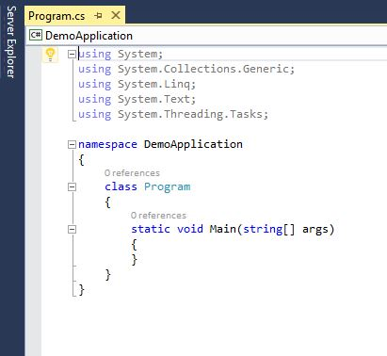
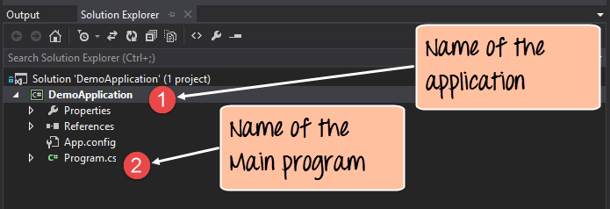
Cont…

Slide 16
Cont…
The 'using' statement is used to import existing .Net modules in our console application.
These modules are required for any .Net application to run properly.
They contain the bare minimum code to make a code work on a Windows machine.
Every application belongs to a class, and every class belongs to a namespace.
A namespace is just a logical grouping of classes.

Slide 17
Cont…
A C# program basically consists of the following parts:
Namespace declaration
A class
Class methods
Class attributes
A Main method
Statements & Expressions
Comments

Slide 18
Cont…
using System;
using System.Collections.Generic;
using System.Text;
namespace ConsoleApplication1
{
class Program
{
static void Main (string[] args)
{
Console.WriteLine("Hello, world!");
}
}
}
You can run your program using Ctrl+F5

Slide 19
Console. Write (…) and Console.WriteLine (…)
They can print all the basic types (string, numeric and primitive types).
Console.WriteLine("Hello World"); => Hello World
Console.WriteLine(5); => 5
Console.WriteLine(3.14159265358979); => 3.14159265358979
Write (…) - Prints on the console what it is provided between the parentheses
WriteLine (…) - This method does what the Write (…) one does but in addition goes to a new line

Slide 20
Formatted Output with Write (…) and WriteLine (…)
static void Main(string[] args)
{
String name = "John";
int age = 18;
String town = "Seattle";
Console.Write("{0} is {1} years old from {2}! \n", name, age, town);
}
Output => John is 18 years old from Seattle

Slide 21
Concatenation of Strings
static void Main(string[] args)
{
int age = 26
string text = "He is " + age + " years old.";
Console.WriteLine(text);
}
Output
He is 26 years old.

Slide 22
Cont…
Be careful during concatenation
Example
string s = "Four: " + 2 + 2;
Console.WriteLine(s);
Output => Four: 22
string s1 = "Four: " + (2 + 2);
Console.WriteLine(s1);
Output => Four: 4

Slide 23
Reading through Console.ReadLine ()
The method Console.ReadLine() provides great convenience for reading from console.
How does it work?
When this method is invoked, the program prevents its work and wait for input from the console.

Slide 24
Cont…
Example
static void Main(string[] args)
{
Console.Write("Please enter your first name: ");
string firstName = Console.ReadLine();
Console.Write("Please enter your last name: ");
string lastName = Console.ReadLine();
Console.WriteLine("Hello, {0} {1}!", firstName, lastName);
}

Slide 25
Reading by Console.ReadKey()
Console.ReadKey() - Waits for key pressing on the console and reads its character equivalent without the need of pressing [Enter].
Console.ReadKey() - Makes the program wait for a key press and it prevents the screen from running and closing quickly when the program is launched
The program will wait for the user to enter any key before finally exiting.
If you don't include this statement in code, the program will exit as soon as it is run.
Reads only one single character from the standard input stream.
Usually used when you're giving options to the user in the console to select from, such as select A, B or C. Another prominent example, Press Y or n to continue.

Slide 26
Reading Numbers
Reading numbers from the console in C# is not done directly.
In order to read a number we should have previously read the input as a string (using ReadLine()) and then convert this string to a number.
The operation of converting a string into another type is called parsing.
int a = int.Parse(Console.ReadLine());

Slide 27
Cont…
Example
static void Main(string[] args)
{
Console.Write("a = ");
int a = int.Parse(Console.ReadLine());
Console.Write("b = ");
int b = int.Parse(Console.ReadLine());
Console.WriteLine("{0} + {1} = {2}", a, b, a + b);
Console.WriteLine("{0} * {1} = {2}", a, b, a * b);
}

Slide 28
Variables and Data Types in C#
Data types: are sets of values that have similar characteristics.
Data types are characterized by:
Name – for example, int;
Size (how much memory they use) – for example, 4 bytes;
Default value – for example 0.

Slide 29
Cont…
Basic data types in C# are distributed into the following types:
Integer types – sbyte, byte, short, ushort, int, uint, long, ulong;
Real floating-point types – float, double;
Real type with decimal precision – decimal;
Boolean type – bool;
Character type – char;
String – string;
Object type – object.
These data types are called primitive (built-in types), because they are embedded in C# language at the lowest level

Slide 30
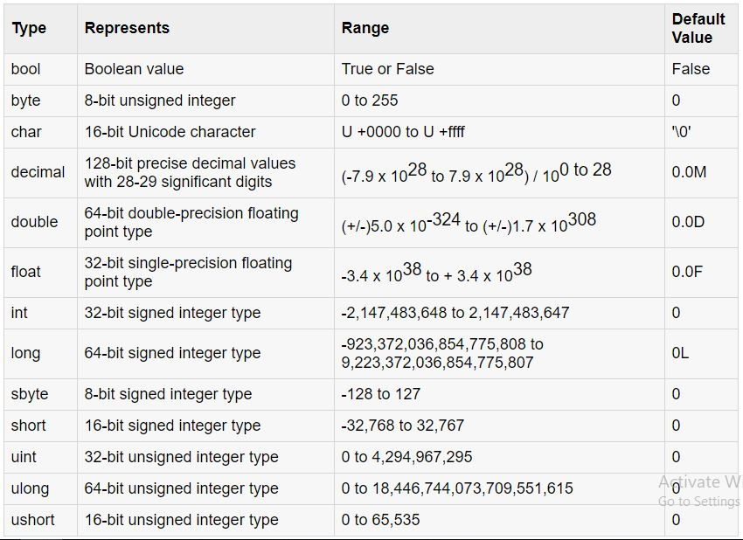
Cont…

Slide 31
What Is a Variable?
A variable is a container/storage of information, which can change its value during execution.
It provides means for:
Storing information;
Retrieving the stored information;
Modifying the stored information.
Variables are characterized by:
Type (of the information preserved in them), for example int;
Name (identifier), for example age;
Value (stored information), for example 25.

Slide 32
Variables Naming Rules
Variable names can contain the letters a-z, A-Z, the digits 0-9 as well as the character '_'.
Variable names cannot start with a digit.
keywords of the C# language can’t be used as a variable names
For example
base, char, default, int, object, this, null and many others cannot be used as variable names.

Slide 33
Declaring & Initializing Variables
Declaration: preparing a variable for storage
Initialization: specifying an initial value.
Setting value to variables at the time of their declaration
<data type> <identifier> [= <initialization>];
E.g. string name =”Abenezer”;

Slide 34
Operators
Operators in C# can be separated in several different categories:
Arithmetic operators – they are used to perform simple mathematical operations. -, +, *, /, %, ++, --
Assignment operators – allow assigning values to variables. =, +=, -=, *=, /=, %=
Comparison operators – allow comparison of two literals and/or variables. ==,!=, >, <, >=, <=
Logical operators – operators that work with Boolean data types and Boolean expressions. &&, ||, !, ^
Binary operators – used to perform operations on the binary representation of numerical data. &, |, ^, ~, <<, >>
Type conversion operators – allow conversion of data from one type to another. (type), as, is, typeof, sizeof

Slide 35
Example
static void Main(string[] args)
{
bool a = true;
bool b = false;
Console.WriteLine(a && b);
Console.WriteLine(a || b);
Console.WriteLine(!b);
Console.WriteLine(b || true);
Console.WriteLine(sizeof(int));
}

Slide 36
Example
static void Main(string[] args)
{
int a = 5;
int b = 4;
Console.WriteLine(a + b);
Console.WriteLine(a + (b++));
Console.WriteLine(a + b);
Console.WriteLine(a + (++b));
Console.WriteLine(a + b);
Console.WriteLine(14 / a);
Console.WriteLine(14 % a);
}

Slide 37
Conditional Control statements
if,
if...else,
if...else if and
Nested if Statement
Switch statement

Slide 38
"if “Statement
if (Boolean expression)
{
Body of the conditional statement;
}
The expression in the brackets which follows the keyword if must return the Boolean value true or false.
If the value is true, then the body of a conditional statement is executed.
If the result is false, then the operators in the body will be skipped.

Slide 39
Example
Console.WriteLine("Enter two numbers.");
Console.Write("Enter first number: ");
int firstNumber = int.Parse(Console.ReadLine());
Console.Write("Enter second number: ");
int secondNumber = int.Parse(Console.ReadLine());
int biggerNumber = firstNumber;
if (secondNumber > firstNumber)
{
biggerNumber = secondNumber;
}
Console.WriteLine("The bigger number is: {0}", biggerNumber);

Slide 40
if...else,
if (Boolean expression)
{
Body of the conditional statement;
}
else
{
Body of the else statement;
}

Slide 41
Example
Console.Write("Enter first number: ");
int num1 = int.Parse(Console.ReadLine());
Console.Write("Enter secondnumber: ");
int num2 = int.Parse(Console.ReadLine());
if (num1 == num2)
{
Console.WriteLine("They are equal!");
}
else
{
Console.WriteLine("They are not equal!");
}

Slide 42
if...else if
if (Boolean expression)
{
Body of the conditional statement;
}
else if
{
Body of the else statement;
}
Else
{
Body of the else statement;
}

Slide 43
Example
int number = 10;
if (number < 10)
{
Console.WriteLine(”{ 0} is less than 10”, number);
}
else if (number > 10)
{
Console.WriteLine(”{ 0} is greater than 10”, number);
}
else
{
Console.WriteLine(”{ 0} is equal to 10”, number);
}

Slide 44
Nested "if" Statements
An if...else statement can exist within another if...else statement
Syntax:
if (boolean-expression)
{
if (nested-expression-1)
{
// code to be executed
}
else
{
// code to be executed
}
}

Slide 45
Example
int first = 5;
int second = 3;
if (first == second)
{
Console.WriteLine("These two numbers are equal.");
}
else
{
if (first > second)
{
Console.WriteLine("The first number is greater.");
}
else
{
Console.WriteLine("The second number is greater.");
}
}

Slide 46
Switch statement
switch (variable_to_be_checked)
{
case value_1:
statements;
break;
case value_2:
statements;
break;
// …
// …
default:
statements;
break;
}
Switch-case chooses which part of the programming code to execute based on the calculated value of a certain expression

Slide 47
Example
string course ;
Console.WriteLine("Please Enter Course Name Below");
course = Console.ReadLine();
switch (course)
{
case "Rad":
Console.WriteLine("It is 2nd year course");
break;
case "c++":
Console.WriteLine("It is 1st year course");
break;
case "multimedia":
Console.WriteLine("It is 3rd year course");
break;
default:
Console.WriteLine("It is SW Eng. course");
break;
}

Slide 48
Example
int number = int.Parse(Console.ReadLine());
switch (number)
{
case 1:
case 4:
case 6:
case 8:
case 10:
Console.WriteLine("The number is not prime!");
break;
case 2:
case 3:
case 5:
case 7:
Console.WriteLine("The number is prime!");
break;
default:
Console.WriteLine("Unknown number!");
break;
}

Slide 49
Loops
Enable us repeated execution of a sequence of operations
While Loop
while (condition)
{
loop body;
}
The body of the while loop may not be executed even once if in the beginning the condition of the cycle returns false

Slide 50
Example
int counter = 0;
while (counter <= 9)
{
Console.ReadKey();
Console.WriteLine(" <= Input Number " + counter);
counter++; // Increment the counter
}

Slide 51
2. Do-While Loop
is similar to the while loop, but it checks the condition after each execution of its loop body
Executes the loop at least once
do
{
executable code;
} while (condition);

Slide 52
Example
int counter = 10;
do{
Console.ReadKey();
Console.WriteLine(" <= Input Number " + counter);
counter++; // Increment the counter
} while (counter <= 9);

Slide 53
3. For Loop
for (initialization; condition; update)
{
loop's body;
}
Example
for (int i = 0; i < 10; i++)
{
Console.WriteLine("i="+i);
}

Slide 54
Nested Loop: Example
int n = int.Parse(Console.ReadLine());
for (int row = 1; row <= n; row++)
{
for (int col = 1; col <= row; col++)
{
Console.Write(col + " ");
}
Console.WriteLine();
}

Slide 55
3. For each Loop
is used to iterate over the elements of the collection. The collection may be an array or a list.
It executes for each element present in the array.
Syntax
foreach(data_type var_name in collection_variable)
{
// statements to be executed
}

Slide 56
Example
int[] a_array = new int[] { 1, 2, 3, 4, 5, 6, 7 };
// foreach loop begin
//it will run till the last element of the array
foreach (int items in a_array)
{
Console.WriteLine(items);
}

Slide 57
difference
for loop executes a statement or a block of statement until the given condition is false.
Whereas foreach loop executes a statement or a block of statements for each element present in the array and there is no need to define the minimum or maximum limit.
In for loop, we iterate the array in both forward and backward directions, e.g from index 0 to 9 and from index 9 to 0.
But in the foreach loop, we iterate an array only in the forward direction, not in a backward direction.
We can not obtain array index using ForEach loop
Foreach loops are not appropriate when you want to modify the array

Slide 58
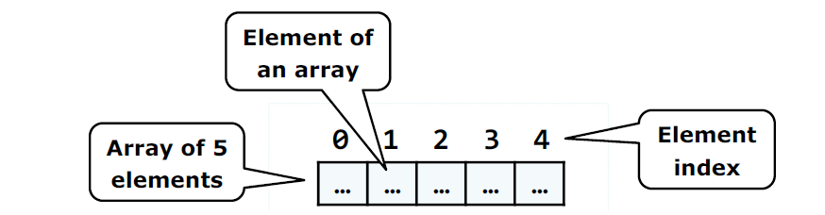
Arrays
Group of memory location that stores the same type of data
Starts at index 0 and ends at Size-1
double[] balance = new double[10];
One-dimensional arrays are also called vectors and two-dimensional are also known as matrices.

Slide 59
Assigning value to arrays
You can assign values to individual array elements
double[] balance = new double[10];
balance[0] = 4500.0;
You can assign values to the array at the time of declaration, like:
double[] balance = { 2340.0, 4523.69, 3421.0};
Or
int [] marks = new int[5] { 99, 98, 92, 97, 95};
int [] marks = new int[] { 99, 98, 92, 97, 95};

Slide 60
Example
int[] n = new int[5];
int i, sum=0;
Console.WriteLine("please Enter 5 numbers");
for (i = 0; i < 5; i++)
{
n[i] =int.Parse(Console.ReadLine());
sum += n[i];
}
Console.WriteLine("SUM=" + sum);

Slide 61
The end!

